Slide 1
Learning Fingerprint Reconstruction: From Minutiae to Image
EEC-521/CIS 634- SOFTWARE ENGINEERING
Team:-
Ganesh Darapaneni
Srikanth Potla
Bharadwaj Chava
DeekshaReddy

Slide 2
ABSTRACT:
In this paper, the prior knowledge about fingerprint ridge structures is encoded in terms of orientation patch and continuous phase patch dictionaries to improve the fingerprint reconstruction. The orientation patch dictionary is used to reconstruct the orientation field from minutiae, while the continuous phase patch dictionary is used to reconstruct the ridge pattern.

Slide 3
EXISTING SYSTEM:
Existing reconstruction algorithms essentially consist of two main steps: i) orientation field reconstruction and ii) ridge pattern reconstruction. The orientation field, which determines the ridge flow, can be reconstructed from minutiae and/or singular points.
In existing work, the orientation field was reconstructed from the singular points (core and delta) using the zeropole model. However, the orientation field in fingerprints cannot simply be accounted for by singular points only.

Slide 4
DISADVANTAGES OF EXISTING SYSTEM:
Although several fingerprint reconstruction algorithms have been proposed, the matching performance of the reconstructed fingerprints compared with the original fingerprint images is still not very satisfactory. That means the reconstructed fingerprint image is not very close to the original fingerprint image that the minutiae were extracted from.

Slide 5
PROPOSED SYSTEM:
We propose to reconstruct fingerprint patches using continuous phase patch dictionary and minutiae belonging to these patches; these patches are optimally selected to form a fingerprint image. The spurious minutiae, which are detected in the phase of the reconstructed fingerprint image but not included in the input minutiae template, are then removed using the global AF-FM model. The proposed reconstruction algorithm has been evaluated on three different public domain databases.

Slide 6
ADVANTAGES OF PROPOSED SYSTEM:
Given the prior knowledge of orientation pattern (i.e., orientation patch dictionary), the orientation field reconstructed from the proposed algorithm is better than the method proposed in existing; the singular points obtained from the proposed algorithm are very close to the original ones.
Experimental results demonstrate that the proposed algorithm performs better than two state of- the-art reconstruction algorithms.

Slide 7
SYSTEM ARCHITECTURE:

Slide 8
HARDWARE REQUIREMENTS:
System : Pentium IV 2.4 GHz.
Hard Disk : 40 GB.
Floppy Drive : 1.44 Mb.
Monitor : 15 VGA Colour.
Mouse : Logitech.
Ram : 512 Mb.

Slide 9
SOFTWARE REQUIREMENTS:
Operating system : Windows XP/7.
Coding Language : C#.net
Tool : Visual Studio 2010
Database : SQL SERVER 2008

Slide 10
MODULES:
Am-Fm Fingerprint Model
Dictionary Construction
Orientation Field Reconstruction
Fingerprint Reconstruction
Fingerprint Image Refinement

Slide 11
Am-Fm Fingerprint Model:
The AM-FM fingerprint model proposed by Larkin and Fletcher represents a fingerprint image I as a hologram, i.e., consisting of 2D amplitude and frequency modulated fringe pattern: I (x, y) = a(x, y) + b(x, y) cos(ψ(x, y)) + n(x, y), (1) where a(x, y), b(x, y) and n(x, y) are, respectively, the offset, amplitude and noise, which make the fingerprint realistic, and ψ(x, y) is the phase which completely determines the ridge structures and minutiae of the fingerprint.

Slide 12
Dictionary Construction:
1) Orientation Patch Dictionary: The orientation patch dictionary proposed by Feng et al. for latent enhancement is directly utilized as prior knowledge of ridge flow for orientation field reconstruction. The orientation patch dictionary DO, consisting of a number of orientation patches, is constructed from a set of high quality fingerprints (50 rolled fingerprint images). An orientation patch consists of 10×10 orientation elements with each orientation element referring to the dominant orientation in a block of size 16 × 16 pixels.

Slide 13
Orientation Field Reconstruction:
The orientation field is considered only in the foreground region of a fingerprint which is determined by dilating the convex hull of the input minutiae points with a disk-shape mask with a radius of 32 pixels. The image is divided into non-overlapping blocks of size 16 × 16 pixels. For the blocks containing minutiae, their orientations are simply replaced by the directions of their corresponding minutiae (modulated by π). Since the minutiae points are usually non-uniformly distributed (sparsely distributed in some regions), it is difficult to select representative orientation patches from DO in the region without minutiae or with one or two minutiae.

Slide 14
Fingerprint Reconstruction:
The continuous phase patch dictionary is used to reconstruct fingerprint image patches based on the reconstructed orientation field and ridge frequency field. Global optimization is then adopted to obtain the reconstructed fingerprint image.
Fingerprint Patch Reconstruction: For a patch p of size 48 × 48 pixels in the initial image (only the reconstructed orientation field and ridge frequency field are available), its orientation field θp with 3 × 3 blocks and average frequency f p are obtained from the reconstructed orientation field and frequency field. The minutiae can be added by combining the continuous phase patch and the spiral phase computed from the minutiae in a patch.

Slide 15
Fingerprint Image Refinement:
We adopt the global AM-FM model to remove the spurious minutiae from the reconstructed image I. The block wise orientation field is expanded to pixel-wise orientation field. The orientation unwrapping method proposed in is adopted to obtain the unwrapped orientation field Ou. For orientation field with singular points, there are horizontal discontinuity segments, which will introduce discontinuity in the unwrapped orientation field and then in the phase image.

Slide 16
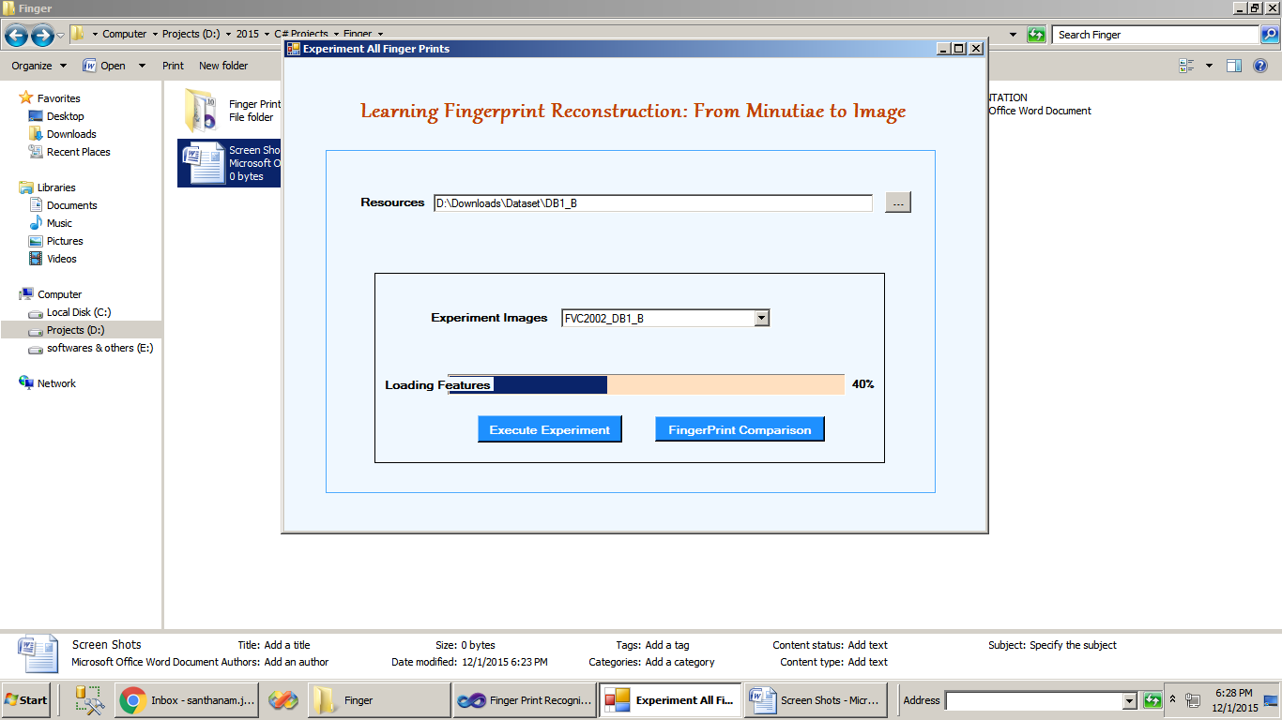

Slide 17
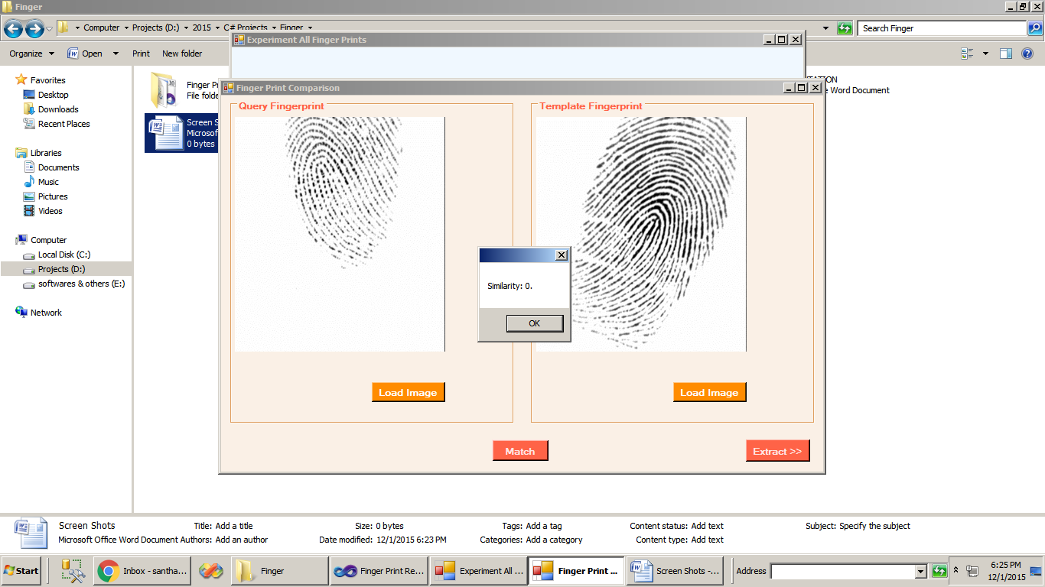

Slide 18
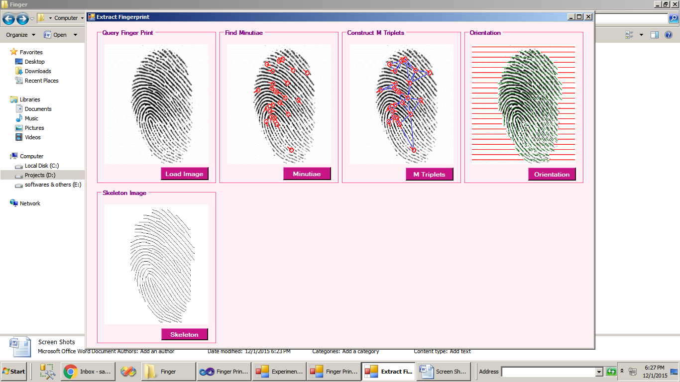

Slide 19
REFERENCE:
Kai Cao and Anil K. Jain, Fellow, IEEE, “Learning Fingerprint Reconstruction: From Minutiae to Image”, IEEE TRANSACTIONS ON INFORMATION FORENSICS AND SECURITY, VOL. 10, NO. 1, JANUARY 2015.

